Slide 1
Generative Models
Gunnvant Saini

Slide 2
Agenda
Multinomial Generative Models
Example
Model Formulation
Estimation
Prediction
Gaussian Generative Models
Example
Estimation
Prediction

Slide 3
Multinomial Generative Models
Mostly used when you are doing text or any kind of sequence classification.

Slide 4
Multinomial Generative Model: Example
Stackoverflow Question | Category
Why lists in python are not immutable? | Python
How to handle threads in Java 8? | Java
In python how to handle concurrency? | Python
…. | Java
… | Python

Slide 5
Multinomial Generative Model: Example
Stackoverflow Question | Category
Why lists in python are not immutable? | Python
How to handle threads in Java 8? | Java
In python how to handle concurrency? | Python
…. | Java
… | Python
To be predicted (y)

Slide 6
Multinomial Generative Model: Example
Stackoverflow Question | Category
Why lists in python are not immutable? | Python
How to handle threads in Java 8? | Java
In python how to handle concurrency? | Python
…. | Java
… | Python
Predictors
To be predicted (y)

Slide 7
Multinomial Generative Model: Model Formulation
Stackoverflow Question | Category
Why lists in python are not immutable? | Python
How to handle threads in Java 8? | Java
In python how to handle concurrency? | Python
…. | Java
… | Python
Predictors
To be predicted (y)
'8', 'handle', 'in', 'threads', 'how', 'to', 'java', 'lists', 'python', 'immutable', 'are', 'concurrency', 'not', 'why'

Slide 8
Multinomial Generative Model: Model Formulation
Stackoverflow Question | Category
Why lists in python are not immutable? | Python
How to handle threads in Java 8? | Java
In python how to handle concurrency? | Python
…. | Java
… | Python
Predictors
To be predicted (y)
'8', 'handle', 'in', 'threads', 'how', 'to', 'java', 'lists', 'python', 'immutable', 'are', 'concurrency', 'not', 'why'
Vocabulary (W)

Slide 9
Multinomial Generative Model: Model Formulation
'8', 'handle', 'in', 'threads', 'how', 'to', 'java', 'lists', 'python', 'immutable', 'are', 'concurrency', 'not', 'why'
Vocabulary (W)
$$P\left(handle\right), P\left(in\right), P\left(threads\right), P\left(how\right)…P(why)$$
$$P\left(handle\right), P\left(in\right), P\left(threads\right), P\left(how\right)…P(why)$$

Slide 10
Multinomial Generative Model: Model Formulation
'8', 'handle', 'in', 'threads', 'how', 'to', 'java', 'lists', 'python', 'immutable', 'are', 'concurrency', 'not', 'why'
Vocabulary (W)
$$P\left(handle\right), P\left(in\right), P\left(threads\right), P\left(how\right)…P(why)$$
python
$$P\left(handle\right), P\left(in\right), P\left(threads\right), P\left(how\right)…P(why)$$
java

Slide 11
Multinomial Generative Model: Model Formulation
'8', 'handle', 'in', 'threads', 'how', 'to', 'java', 'lists', 'python', 'immutable', 'are', 'concurrency', 'not', 'why'
Vocabulary (W)
$$P\left(handle\right), P\left(in\right), P\left(threads\right), P\left(how\right)…P(why)$$
python
$$P\left(handle\right), P\left(in\right), P\left(threads\right), P\left(how\right)…P(why)$$
java
Sent = The sets in python are immutable.

Slide 12
Multinomial Generative Model: Model Formulation
'8', 'handle', 'in', 'threads', 'how', 'to', 'java', 'lists', 'python', 'immutable', 'are', 'concurrency', 'not', 'why'
Vocabulary (W)
$$P\left(handle\right), P\left(in\right), P\left(threads\right), P\left(how\right)…P(why)$$
python
$$P\left(handle\right), P\left(in\right), P\left(threads\right), P\left(how\right)…P(why)$$
java
Sent = The sets in python are immutable. = {the, sets, in, python, are, immutable}

Slide 13


Multinomial Generative Model: Model Formulation
'8', 'handle', 'in', 'threads', 'how', 'to', 'java', 'lists', 'python', 'immutable', 'are', 'concurrency', 'not', 'why'
Vocabulary (W)
$$P\left(handle\right), P\left(in\right), P\left(threads\right), P\left(how\right)…P(why)$$
python
$$P\left(handle\right), P\left(in\right), P\left(threads\right), P\left(how\right)…P(why)$$
java
Sent = The sets in python are immutable. = {the, sets, in, python, are, immutable}
$$P\left(Sent | python\right)=∏P_{w}^{count\left(w\right)} ∀ w∈W$$
$$P\left(Sent | java\right)=∏P_{w^{′}}^{count\left(w^{′}\right)} ∀ w′∈W$$

Slide 14
Multinomial Generative Model: Estimation
'8', 'handle', 'in', 'threads', 'how', 'to', 'java', 'lists', 'python', 'immutable', 'are', 'concurrency', 'not', 'why'
Vocabulary (W)
$$P\left(handle\right), P\left(in\right), P\left(threads\right), P\left(how\right)…P(why)$$
python
$$P\left(handle\right), P\left(in\right), P\left(threads\right), P\left(how\right)…P(why)$$
java
These have to be estimated

Slide 15


Multinomial Generative Model: Estimation (Binary Vocabulary)
$$w_{1},w_{2}$$
Vocabulary (W)
$$P\left(w_{1}\right),1−P\left(w_{1}\right)=θ_{1},1−θ_{1}$$
Class 1
$$P\left(w_{1}\right),1−P\left(w_{1}\right)={θ′}_{1},1−{θ′}_{1}$$
Class 2
These have to be estimated

Slide 16
Multinomial Generative Model: Estimation (Binary Vocabulary)
$$w_{1},w_{2}$$
Vocabulary (W)
S1 = w1w2w1w2
S2 = w2w2w1w2
S3 = w1w1w2w2w1
…
…
Sn= w1w1w2w2w1w1

Slide 17
Multinomial Generative Model: Estimation (Binary Vocabulary)
$$w_{1},w_{2}$$
Vocabulary (W)
S1 = w1w2w1w2
S2 = w2w2w1w2
S3 = w1w1w2w2w1
…
…
Sn= w1w1w2w2w1w1
$$P\left(w_{1}\right),1−P\left(w_{1}\right)=θ_{1},1−θ_{1}$$
Class 1

Slide 18
Multinomial Generative Model: Estimation (Binary Vocabulary)
$$w_{1},w_{2}$$
Vocabulary (W)
$$P\left(w_{1}\right),1−P\left(w_{1}\right)=θ_{1},1−θ_{1}$$
Class 1
S1 = w1w2w1w2
S2 = w2w2w1w2
S3 = w1w1w2w2w1
…
…
Sn= w1w1w2w2w1w1
w1w2w1w2
w2w2w1w2
w1w1w2w2w1
…
…
w1w1w2w2w1w1
Concatenate all the documents
Estimate the P(Corpus|Class)

Slide 19

Multinomial Generative Model: Estimation (Binary Vocabulary)
$$w_{1},w_{2}$$
Vocabulary (W)
$$P\left(w_{1}\right),1−P\left(w_{1}\right)=θ_{1},1−θ_{1}$$
Class 1
S1 = w1w2w1w2
S2 = w2w2w1w2
S3 = w1w1w2w2w1
…
…
Sn= w1w1w2w2w1w1
w1w2w1w2
w2w2w1w2
w1w1w2w2w1
…
…
w1w1w2w2w1w1
Concatenate all the documents
Estimate the P(Corpus|Class)
Use Maximum Likelihood for estimation
$$L\left(D|θ\right)=∏θ_{w}^{count\left(w\right)} ∀w∈\{w_{1},w_{2}\}$$

Slide 20

Multinomial Generative Model: Estimation (Binary Vocabulary)
$$w_{1},w_{2}$$
Vocabulary (W)
$$P\left(w_{1}\right),1−P\left(w_{1}\right)=θ_{1},1−θ_{1}$$
Class 1
S1 = w1w2w1w2
S2 = w2w2w1w2
S3 = w1w1w2w2w1
…
…
Sn= w1w1w2w2w1w1
w1w2w1w2
w2w2w1w2
w1w1w2w2w1
…
…
w1w1w2w2w1w1
Concatenate all the documents
Estimate the P(Corpus|Class)
Use Maximum Likelihood for estimation
$$max L\left(D|θ\right)= ∏θ_{w}^{count\left(w\right)} ∀w∈\{w_{1},w_{2}\}$$

Slide 21
Multinomial Generative Model: Estimation (Binary Vocabulary)
$$w_{1},w_{2}$$
Vocabulary (W)
$$P\left(w_{1}\right),1−P\left(w_{1}\right)=θ_{1},1−θ_{1}$$
Class 1
S1 = w1w2w1w2
S2 = w2w2w1w2
S3 = w1w1w2w2w1
…
…
Sn= w1w1w2w2w1w1
w1w2w1w2
w2w2w1w2
w1w1w2w2w1
…
…
w1w1w2w2w1w1
Concatenate all the documents
Estimate the P(Corpus|Class)
Use Maximum Likelihood for estimation
$$max log⁡(L\left(D|θ\right))=max log⁡(∏θ_{w}^{count\left(w\right)}) ∀w∈\{w_{1},w_{2}\}$$

Slide 22
Multinomial Generative Model: Estimation (Binary Vocabulary)
$$w_{1},w_{2}$$
Vocabulary (W)
$$P\left(w_{1}\right),1−P\left(w_{1}\right)=θ_{1},1−θ_{1}$$
Class 1
S1 = w1w2w1w2
S2 = w2w2w1w2
S3 = w1w1w2w2w1
…
…
Sn= w1w1w2w2w1w1
w1w2w1w2
w2w2w1w2
w1w1w2w2w1
…
…
w1w1w2w2w1w1
Concatenate all the documents
Estimate the P(Corpus|Class)
Use Maximum Likelihood for estimation
$$max log⁡(L\left(D|θ\right))=max ∑count\left(w\right)log⁡(θ_{w}) ∀w∈\{w_{1},w_{2}\}$$

Slide 23
Multinomial Generative Model: Estimation (Binary Vocabulary)
$$w_{1},w_{2}$$
Vocabulary (W)
$$P\left(w_{1}\right),1−P\left(w_{1}\right)=θ_{1},1−θ_{1}$$
Class 1
S1 = w1w2w1w2
S2 = w2w2w1w2
S3 = w1w1w2w2w1
…
…
Sn= w1w1w2w2w1w1
w1w2w1w2
w2w2w1w2
w1w1w2w2w1
…
…
w1w1w2w2w1w1
Concatenate all the documents
Estimate the P(Corpus|Class)
Use Maximum Likelihood for estimation
$$max\log\left(L\left(D|θ\right)\right)=\max{ }count\left(w_{1}\right)\log\left(θ_{1}\right)+count\left(w_{2}\right)log⁡(1−θ_{1}) ∀w∈\{w_{1},w_{2}\}$$

Slide 24
Multinomial Generative Model: Estimation (Binary Vocabulary)
$$w_{1},w_{2}$$
Vocabulary (W)
$$P\left(w_{1}\right),1−P\left(w_{1}\right)=θ_{1},1−θ_{1}$$
Class 1
S1 = w1w2w1w2
S2 = w2w2w1w2
S3 = w1w1w2w2w1
…
…
Sn= w1w1w2w2w1w1
w1w2w1w2
w2w2w1w2
w1w1w2w2w1
…
…
w1w1w2w2w1w1
Concatenate all the documents
Estimate the P(Corpus|Class)
Use Maximum Likelihood for estimation
$$\frac{∂\log\left(L\left(D|θ\right)\right)}{∂(θ)}=\frac{∂(count\left(w_{1}\right)\log\left(θ_{1}\right)+count\left(w_{2}\right)log⁡(1−θ_{1}))}{∂θ_{1}} ∀w∈\{w_{1},w_{2}\}$$

Slide 25
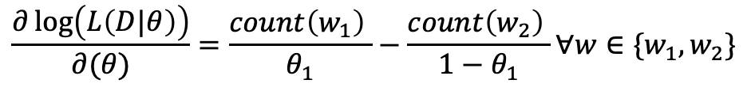
Multinomial Generative Model: Estimation (Binary Vocabulary)
$$w_{1},w_{2}$$
Vocabulary (W)
$$P\left(w_{1}\right),1−P\left(w_{1}\right)=θ_{1},1−θ_{1}$$
Class 1
S1 = w1w2w1w2
S2 = w2w2w1w2
S3 = w1w1w2w2w1
…
…
Sn= w1w1w2w2w1w1
w1w2w1w2
w2w2w1w2
w1w1w2w2w1
…
…
w1w1w2w2w1w1
Concatenate all the documents
Estimate the P(Corpus|Class)
Use Maximum Likelihood for estimation
$$\frac{∂\log\left(L\left(D|θ\right)\right)}{∂(θ)}=\frac{count\left(w_{1}\right) }{θ_{1}}−\frac{count\left(w_{2}\right) }{1−θ_{1}}∀w∈\{w_{1},w_{2}\}$$

Slide 26
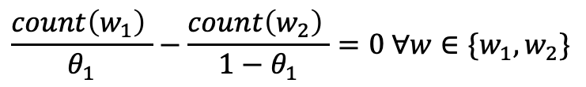
Multinomial Generative Model: Estimation (Binary Vocabulary)
$$w_{1},w_{2}$$
Vocabulary (W)
$$P\left(w_{1}\right),1−P\left(w_{1}\right)=θ_{1},1−θ_{1}$$
Class 1
S1 = w1w2w1w2
S2 = w2w2w1w2
S3 = w1w1w2w2w1
…
…
Sn= w1w1w2w2w1w1
w1w2w1w2
w2w2w1w2
w1w1w2w2w1
…
…
w1w1w2w2w1w1
Concatenate all the documents
Estimate the P(Corpus|Class)
Use Maximum Likelihood for estimation
$$\frac{count\left(w_{1}\right) }{θ_{1}}−\frac{count\left(w_{2}\right) }{1−θ_{1}}=0 ∀w∈\{w_{1},w_{2}\}$$

Slide 27
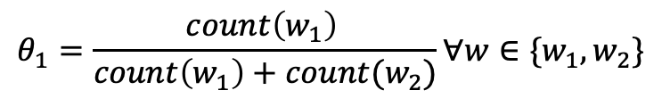
Multinomial Generative Model: Estimation (Binary Vocabulary)
$$w_{1},w_{2}$$
Vocabulary (W)
$$P\left(w_{1}\right),1−P\left(w_{1}\right)=θ_{1},1−θ_{1}$$
Class 1
S1 = w1w2w1w2
S2 = w2w2w1w2
S3 = w1w1w2w2w1
…
…
Sn= w1w1w2w2w1w1
w1w2w1w2
w2w2w1w2
w1w1w2w2w1
…
…
w1w1w2w2w1w1
Concatenate all the documents
Estimate the P(Corpus|Class)
Use Maximum Likelihood for estimation
$$θ_{1}=\frac{count\left(w_{1}\right) }{count\left(w_{1}\right)+count(w_{2})}∀w∈\{w_{1},w_{2}\}$$

Slide 28
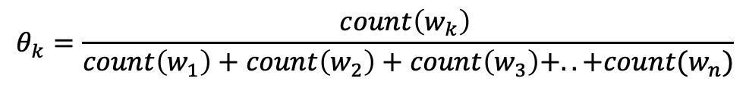

Multinomial Generative Model: Estimation (Non Binary Vocabulary)
$$w_{1},w_{2}, w_{3}, …, w_{n}$$
Vocabulary (W)
S1 = w1w2w1w2w4
S2 = w2w2w1w2wn
S3 = w1w1w2w2w1w6
…
…
Sn= w1w1w2w2w1w1w81
w1w2w1w2w4
w2w2w1w2wn
w1w1w2w2w1w6
…
…
w1w1w2w2w1w1w81
Concatenate all the documents
Estimate the P(Corpus|Class)
Use Maximum Likelihood for estimation
$$θ_{k}=\frac{count\left(w_{k}\right) }{count\left(w_{1}\right)+count\left(w_{2}\right)+count\left(w_{3}\right)+..+count(w_{n})}$$

Slide 29
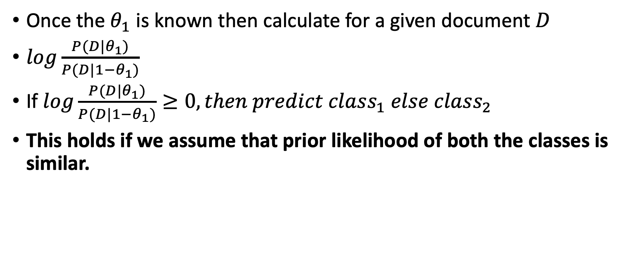
Multinomial Generative Model: Prediction
Once the $θ_{1}$ is known then calculate for a given document $D$
$log\frac{P(D|θ_{1})}{P(D|1−θ_{1})}$
If $log\frac{P(D|θ_{1})}{P(D|1−θ_{1})}≥0, then predict class_{1} else class_{2}$
This holds if we assume that prior likelihood of both the classes is similar.

Slide 30
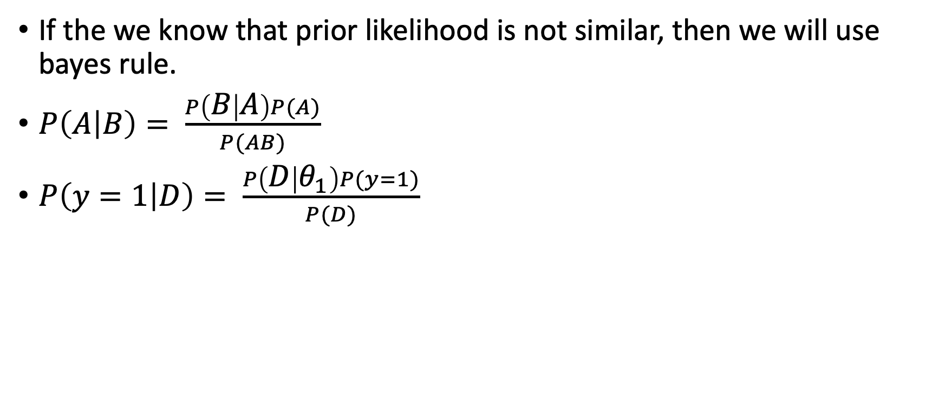
Multinomial Generative Model: Prediction
If the we know that prior likelihood is not similar, then we will use bayes rule.
$P\left(A | B\right)= \frac{P\left(B | A\right)P(A)}{P(AB)}$
$P\left(y=1 | D\right)= \frac{P\left(D | θ_{1}\right)P(y=1)}{P(D)}$

Slide 31
Gaussian Generative Models: Example

